Slide 1

IMPACT OF DIGTALIZATION ON INDIAN FINANCIAL SYSTEM
By PRATHAM GOYAL
19115093

Slide 2
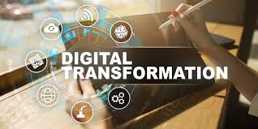
WHAT IS DIGITALIZATION?
Digitalization is the generic term for the Digital Transformation of society and the economy.
It describes the transition from an industrial age characterized by analogue technologies to an age of knowledge and creativity characterized by digital technologies

Slide 3
A Very Short History of Digitalization
The 1990s saw the entrance of technology in India and people were introduced with the use of computers and internet.
The path toward digitalization in India started with the e-commerce start-ups, such as FlipKart, Jabong, SnapDeal etc.
In a developing country like India the process of digital soundness has been slow and got a huge push to go digital when the demonetization shook everyone on 8th November,2016.
According to media reports, including in the Economic Times, transactions in e-wallet companies had increased by more than 700% in the first few days after demonetization.

Slide 4
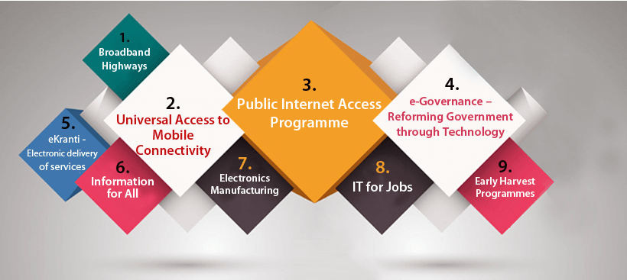
Initiatives taken by Government
A very important initiative is the Digital India . Digital India is a campaign launched by the Government of India on July 1, 2015 under the visionary leadership of Hon’ble Prime Minister, Shri Narendra Modi.
Under this program India is on its way to becoming a digitally advanced country through the launch of various projects and initiatives such as MyGov.in, Digi Locker, e-hospital, e-education, etc.
GST Council has announced in the 29th GST Council meeting an incentive in the form of a cashback to consumers for making payments of their GST Bills via prescribed Digital modes.

Slide 5
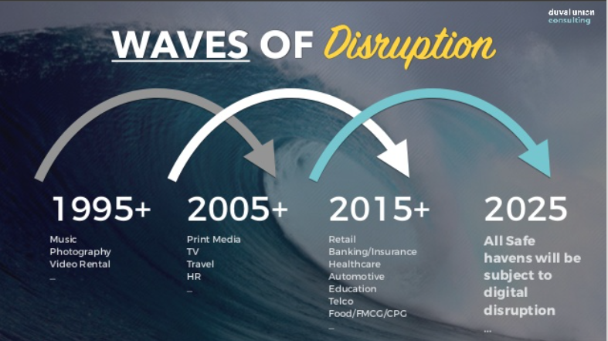
Impacts of Digitalization

Slide 6
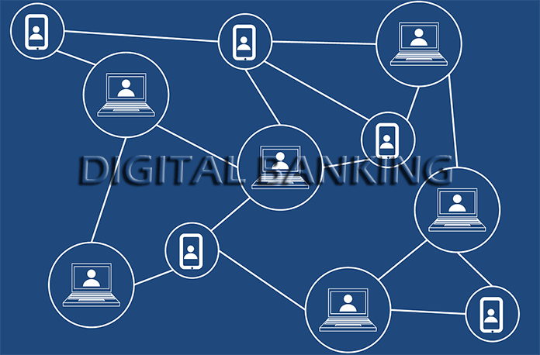

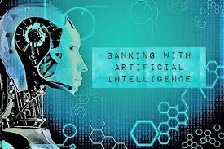
HOW IS DIGITALization CHANGING THE FINANCIAL INDUSTRY?
The key changes that are shaping the financial industry due to digitalization:-
Blockchain Technology
Machine Learning Technologies
Evolving Workforce
Digital Banking and digital modes of payments

Slide 7
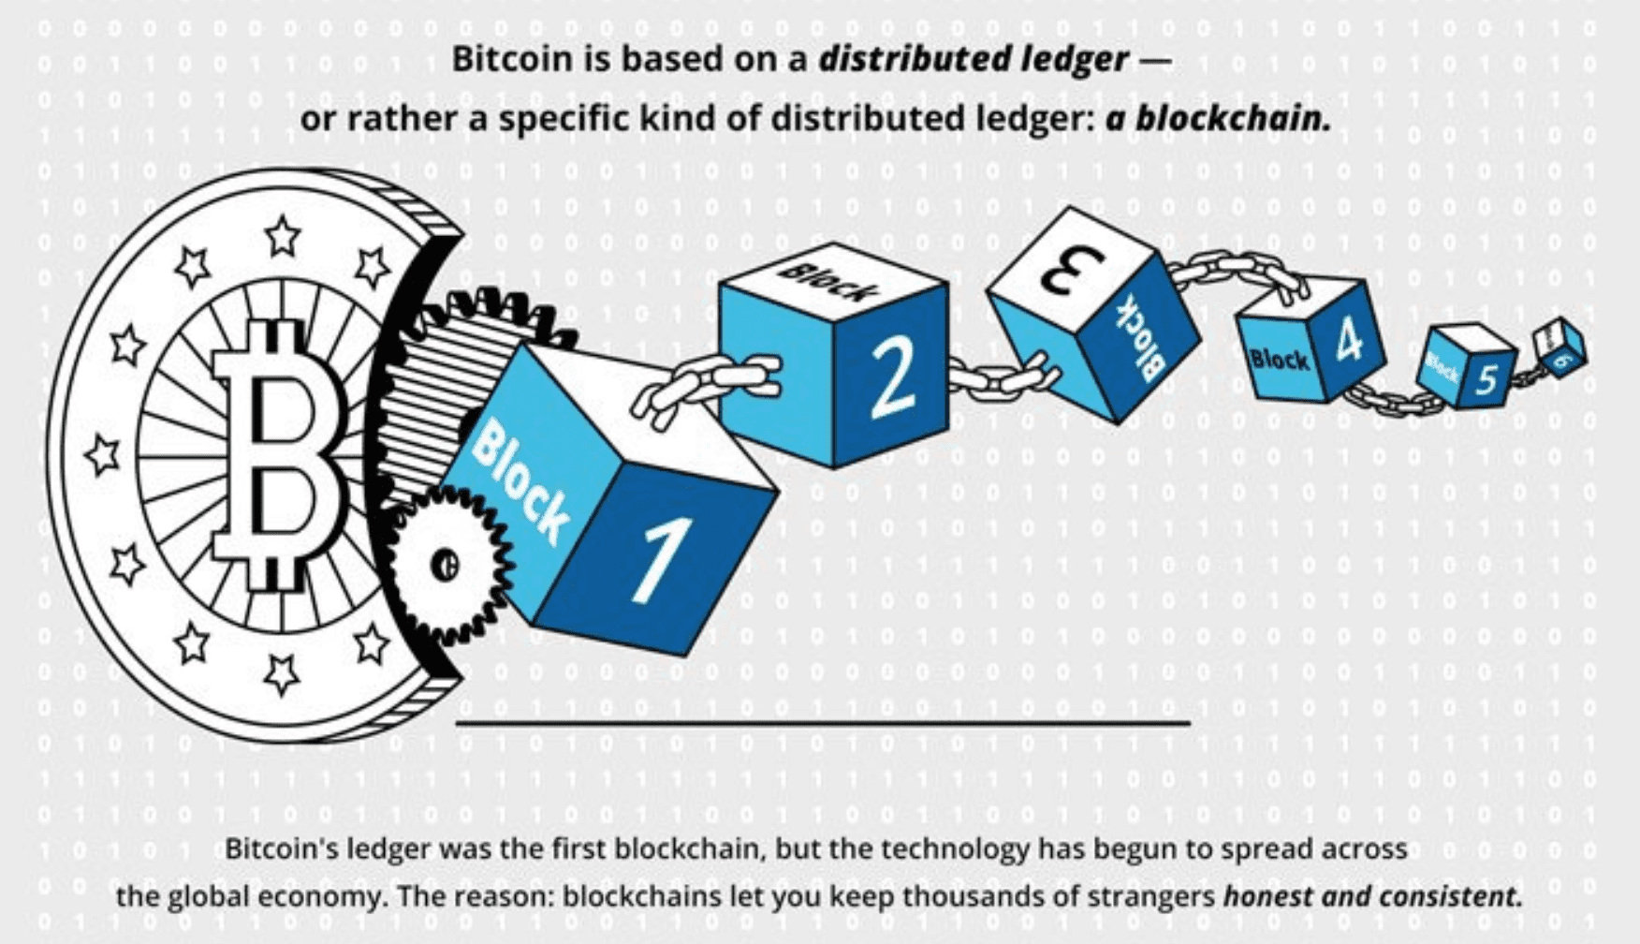
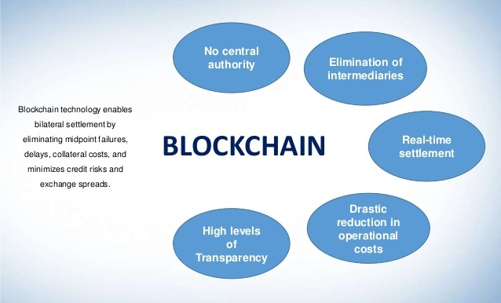
BLOCKCHAIN Technology In Finance
It is a technology that allows blocks of information to be created and stored in a chain. Each time a new block is created it is added to this chain to form what has been called a ’digital ledger‘.
Advantages:-
Decentralized
Secure
Unalterable
A MarketWatch report states that total investment in blockchain in the banking and financial services sector amounted to $2.3 billion in 2018. The report states that this spending will likely reach $17.47 billion by the end of 2025, with a CAGR of 33.6% during the 2019-2025 period.

Slide 8
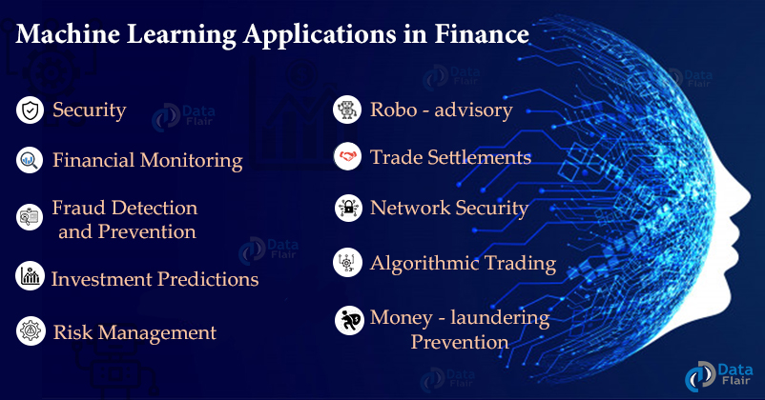
Machine Learning Technologies In Finance
Machine learning (ML) is a subset of data science that uses statistical models to draw insights and make predictions.
ML is very important to enable digitalization of services.
Advantages/Applications in finance:-
Process Automation(chatbots ,call center automation ,etc.)
Security
Algorithmic trading
Robo-Advisory

Slide 9
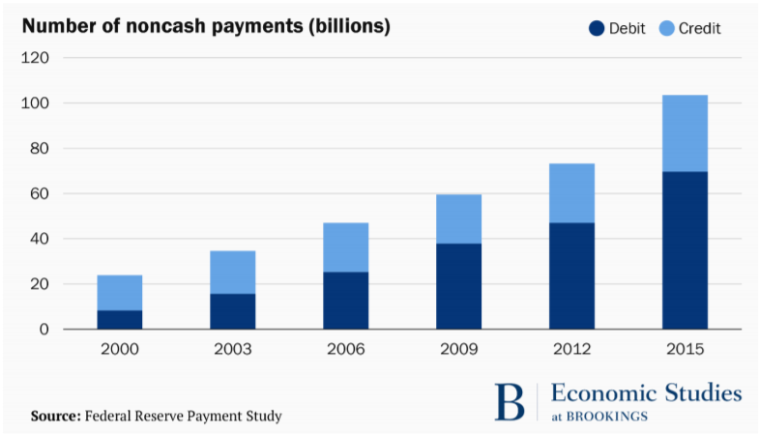
DIGITAL BANKING
Digital Banking is a technology where banking services are delivered over the internet via applications and websites.
Digital Banking includes various digital modes of payments such as:-
UPI
AEPS
Cards
E-Wallets

Slide 10
Advantages and Disadvantages of Digital Banking
Advantages:-
Cost effective for banks
No need to handle large amounts of cash
24*7 access to accounts
Record of past transactions is automatically stored so no need to keep track of that manually
Convenient for customers as transactions can be made from anywhere
Accuracy increased
Several accounts can be managed through internet banking
The biggest disadvantage of using digital banking is the risk of data thefts and frauds.

Slide 11
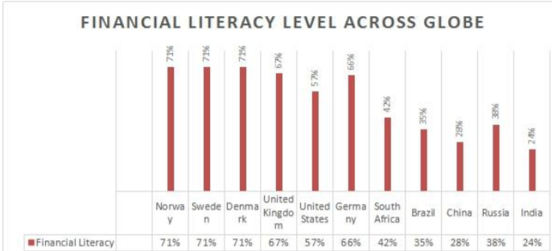
OBSTACLES IN THE PROCESS OF DIGITALIZATION
The resistance of the people to change during emergence of new technologies.
People fear that using the new technologies their money might be lost as they are not very secure.
Lack of knowledge about its uses and benefits.
Infrastructure requirement and its unavailability.
Lack of financial literacy among people.

Slide 12
Conclusion
The digitalization brings innovation, ease of working , new job opportunities and growth in the economy. It helps to bring transparency in the system and more transparent are the flow of funds in the economy and resolves many problems like tax evasion etc. But with all these benefits available it also makes it necessary for the people to have basic financial knowledge and a push towards the importance of the financial literacy. Also more technologies like blockchain and machine learning must be used to enhance the security and eliminate the chances of frauds.

Slide 13
Thanks

